Slide 1

Leaders' School & College Chattogram
Class: IX (Bangla Version)
L#02
Topic Name: Escape Sequences, Variables and Data Types
Md. Amin Kaiser
B.Sc. in CSE, DUET
Assistant Teacher(ICT)
E-mail: aminkaiser90@gmail.com

Slide 2
Contents
More About print()
Use of Escape Sequences
Comments on Python
Variables
Data Types

Slide 3
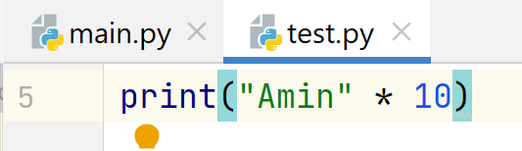
More About print()
10x Print Your Name: Simple Solution!
Output:

Slide 4

Escape Sequences
Escape sequences allow you to insert special characters in strings.
Put a backslash (\) before the character you want to escape.
\n: Newline
\t: Tab
\”: Double Quote
10x Print Your Name: Simple Solution!
Output:

Slide 5

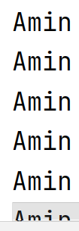
Escape Sequences: New Line
10x Print Your Name: Simple Solution!
Output:
…
…

Slide 6
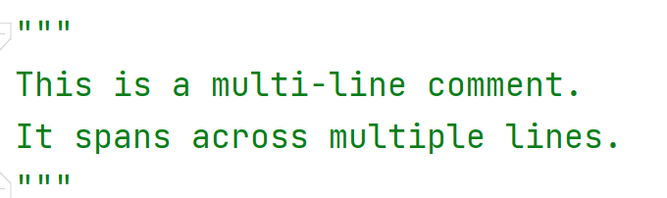
Comments on Python
Used to include explanatory or descriptive text within the code that is not executed as part of the program
They are intended to provide additional information to readers and developers of the code.
Single Line Comments: Start with #
Multi-line Comments:

Slide 7

Variables
Variables are used to store values in memory
Python does not require you to explicitly declare the data type of a variable.
When you assign a value to a variable, Python automatically assigns a data type based on the value.
You can assign a value to a variable using the assignment operator (=).
The general syntax is:
variable_name = value

Slide 8
Variables: Some Rules to Follow
Variable names must start with a letter or underscore (_), but not with a number.
Variable names can only contain letters, numbers, and underscores.
Variable names are case sensitive. For example, "myVar" and "myvar" are two different variables.
You cannot use reserved keywords as variable names, such as "if," "while," "for," "and," "or," "not," and "else.“
It's a good practice to use descriptive and meaningful variable names, so it's easy to understand the purpose of the variable.

Slide 9
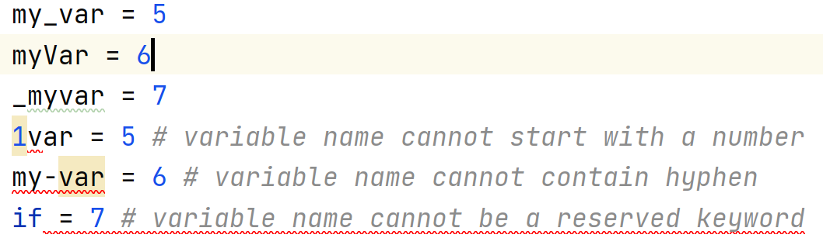
Variables: Some Rules to Follow

Slide 10
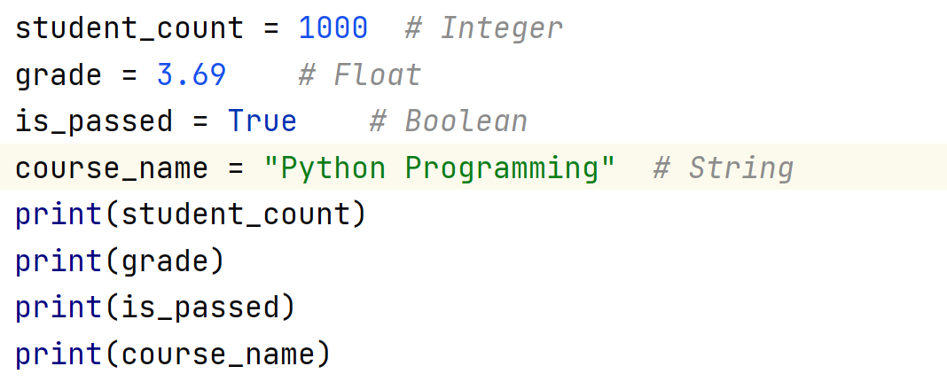
Data Types
Integer: Whole numbers without decimals (e.g., 5, -10).
Float: Real numbers with decimals (e.g., 3.14, -2.5).
String: A sequence of characters (e.g., "Hello", 'Python').
Boolean: Represents either True or False.

Slide 11
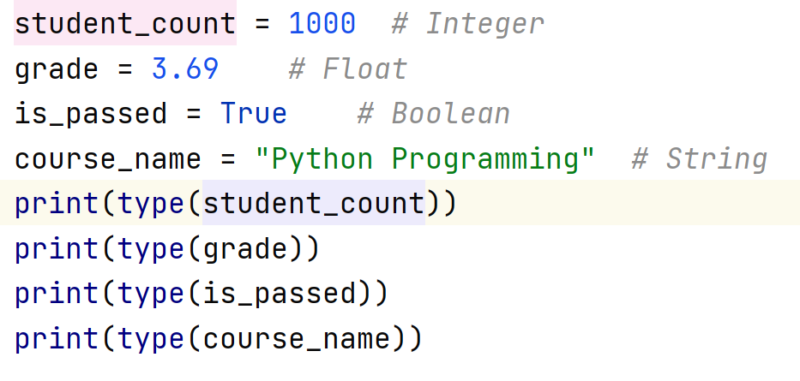
Check Data Type
type(): function is used to determine the type of an object.

Slide 12

Q/A Session

